Slide 1
Cyber Crimes and Security
Made by: Haris Kabir, Saad Dar, Abdullah Gohar and Sohaib Shamsi

Slide 2
Computers and risks:
Everything is stored on computers:
Pictures and personal data in case of individuals and complete records in case of companies.
This data can be damaged accidentally:
Destruction due to fire or water, accidental deletion, file corruption.
Or this data can be damaged intentionally:
Accessing data remotely or destruction of data to revenge or to give trouble for personal benefits.

Slide 3
What is Cyber Crime?
A crime that involves a computer and a network.
Computer may have been used in the commission of a crime, or it may be the target.
Used steal user’s personal information, confidential business information, government information, or disable a device.
It is also a cybercrime to sell or extort the above information online.

Slide 4
What is a cyber attack?
Saad ,shopping cart.com and his important credentials.
Faster and hassle free shopping experience.

Slide 5
The phishing Email
Saad does not realise the danger and loses all of his savings.

Slide 6
How do you think this happened?
Yes, fake email which lead to unauthorized third-party access.

Slide 7
Types of Cyber attacks:
Malware attacks
Phishing attack
Man-in-the-middle attack
Password attack

Slide 8
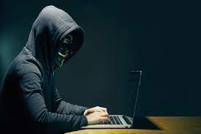
Virus, spyware, ransomware
Viruses are malware that are attached to other files in your system and may be used to destroy your data. Viruses have many capabilities and require human interaction to spread from system to system.
Spyware is malware that steals your data and may be used to spy on you by using your webcam or microphone without your knowledge.
Ransomware is a relatively new term for malware that makes all of your files unreadable, holding your data hostage until you pay the hacker the ransom.

Slide 9
How can they be harmful for user?
Can cause financial losses to individuals and corporate sector
Privacy of individuals is compromised
In case cyber attack at government or defence sector, then capabilities to defend an incoming attack are exposed
Important or secrete data can be exposed or leak

Slide 10

Some tips to remain safe from cyber crimes:
Keeping the strong password:
protect your password by using a trusted password generator or having a combination of alphabets, numbers and symbols in the chosen password
Keeping the anti-virus softwares updated:
The anti-virus updates contain the latest files needed to combat new viruses and protect your computer.
Do not post your personal and private information:
The name of your pets, your pre school etc etc
this should not be posted many websites ask these questions to be answered in case of forgetting the password or suspicion
Always check padlock sign and the link for https:
Do not enter any financial information incase you feel website
is suspicious.

Slide 11
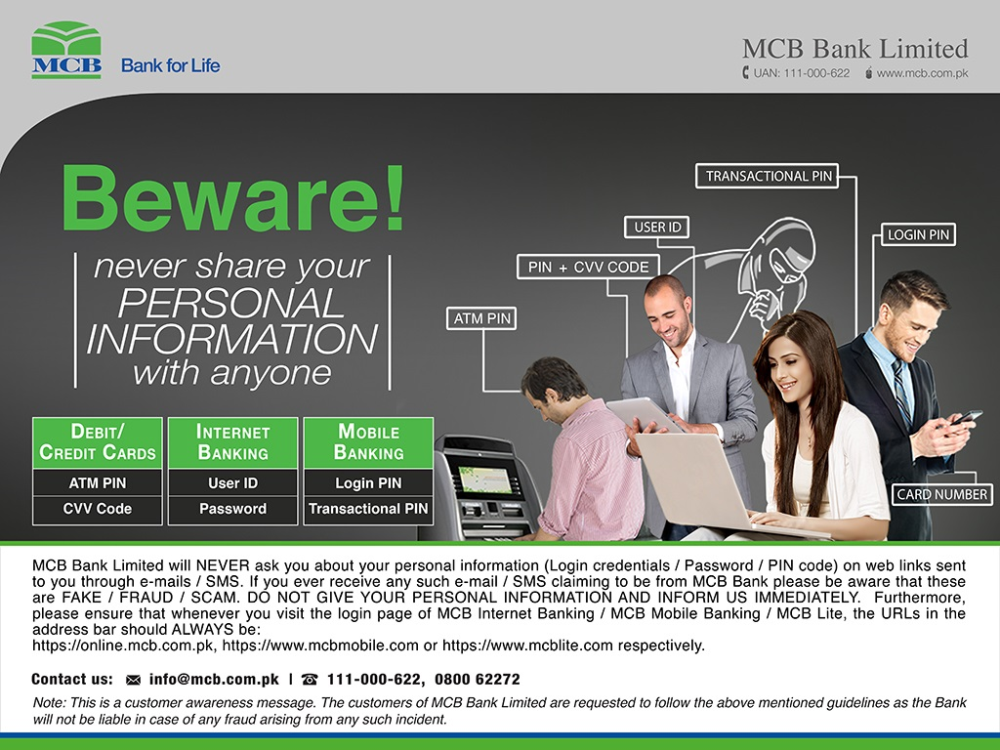
Some tips to remain safe from financial frauds from major bank in Pakistan

Slide 12
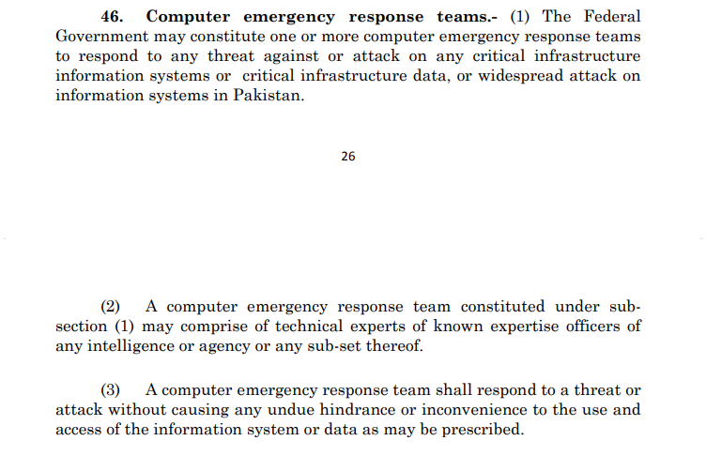
Measures in case of Cyber Attack in Pakistan:
Section VI, The Prevention of Electronic Crimes Act, 2016.

Slide 13
Rules and Regulations for Cyber Crimes in Pakistan
Unauthorized access to information system or data.- Whoever with dishonest intention gains unauthorized access to any information system or data shall be punished with imprisonment for a term which may extend to three months or with fine which may extend to fifty thousand rupees or with both.
Malicious code.-Whoever willfully and without authorization writes, offers, makes available, distributes or transmits malicious code through an information system or device, with intent to cause harm to any information system or data resulting in the corruption, destruction, alteration, suppression, theft or loss of the information system or data shall be punished with imprisonment for a term which may extend to two years or with fine which may extend to one million rupees or with both.
Section II, The Prevention of Electronic Crimes Act, 2016.

